Slide 1
XNOR-Net and Binary Connect Hardware Design
Lucas B., Bibrak C., Adam D., Prateek S.
E501 Design Project Presentation
4/16/2018

Slide 2
Introduction
Hardware designs were created to implement the basic hardware building blocks of the following papers:
“XNOR-Net: ImageNet Classification Using Binary Convolutional Neural Networks”
“BinaryConnect: Training Deep Neural Networks with binary weights during propagations”

Slide 3
Feed-forward network using a trained neural network model
For the current scope of the project, we consider MNIST dataset which consists of 10 classes of images i.e. 0 to 9.
Once the training of the neural network is done using any machine, our hardware design focuses on achieving speedup in the classification phase.
The weights learned by the neural network will be inserted in the module using a BRAM to the feed forward network.
These weights along with the images to be classified would be used as an input to the feed forward network on an FPGA.
The scope of our project is only defined for the implementation of the fully connected layer after the convolutions have been done.

Slide 4
Convolution Layer 1
Convolution Layer 2
Fully Connected Layer
Maxpooling
Maxpooling
0
1
2
3
4
20 Images
50 Images
5
Input Image Size
28x28
6
7
8
20x24x24
Kernel Size : 5x5
20 Different Kernels
20x12x12
Kernel Size : 2x2
20 Different Kernels
50x8x8
Kernel Size : 5x5
50 Different Kernels
50x4x4
Kernel Size : 2x2
50 Different Kernels
9
Vector Size: 800
Vector Size: 500
Vector Size: 10

Slide 5
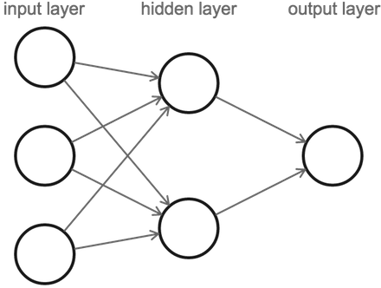
Fully Connected Layer
Input Layer becomes a vector, the weights which are multiplied and accumulated become a matrix. This whole process of Matrix and Vector multiplication along with accumulation is simply a Matrix-Vector Multiplication.
Input Vector (I) : 800 x 1
Weight Matrix (W1) : 500 x 800
Hidden Layer (H) : H = W1 x I = [500 x 800] [800 x 1] = [500 x 1]
Weight Matrix (W2) : 10 x 500
Output Layer (O) : O = W2 x H = [10 x 500] [500 x 1] = [10 x 1]
This output layer which is a vector of 10 values classifies all the images in the possible 10 numbers according to MNIST Data Set we use.

Slide 6
[8x1 vector] Vi (32-bit fixed point)
XNOR-Net
Controller (FSM to control RAM and mux)
Control signals
Multiplexor
[8x8 matrix] Wi (binary)
[8x1 vector] (32-bit fixed point)​
RAM
(BRAM on FPGA)
Normalizer​
alphai (signed 16-bit fixed)
[8x1 vector] (binary)
XNOR+POPCOUNT
[8x1 vector] (16-bit fixed point)​
Scalar Multiplication (alpha Normalization)
Betai (signed 16-bit fixed)
(from Normalizer)
[8x1 vector] (16-bit fixed point)​
Scalar Multiplication (alpha Normalization)
[8x1 vector] (32-bit fixed point)​

Slide 7
Binary Connect
Controller (FSM to control RAM and mux)
Control signals
Address/Control signals
Vi = [8x1 vector] (32-bit fixed point)
RAM
(BRAM on FPGA)
[8x8 matrix] Wi (binary)
Multiplexor
alphai (32-bit fixed point)
[8x1 vector] (16-bit fixed point)​
Accumulator
[8x1 vector] (16-bit fixed point)​
Scalar Multiplication (alpha Normalization)
[8x1 vector] (32-bit fixed point)​

Slide 8
XNOR-Net Core Components | Binary Connect Core Components
XNOR + Popcount Design Concept Performs multiplication and accumulation(MAC) operation optimizations. | Accumulator Performs multiplication and accumulation(MAC) operation optimizations.
Alpha and Beta Multipliers Performs multiplication of vector to scalar | Alpha Multiplier Performs multiplication of vector to scalar

Slide 9
Modules

Slide 10
Popcount Design Concept 1 (Slow)
Purely ripple carry adder (RCA) combination
RCA [31:30]
RCA
Numbits = 32
8bit RCA
8bit RCA
8bit RCA
(sub)
RCA [29:28]
…
input
…
…
RCA [3:2]
RCA
…
RCA [1:0]
Also, If you simply count the number of ones in a string, you need to apply:
POPCOUNT = (NUMBER OF ONES) * 2 – (NUMBER OF BITS)

Slide 11
Popcount Design Concept 2 (Better)
4 bit lookup table
Input [3:0] | Popcount
0000 | 0
0001 | 1
0010 | 1
0011 | 2
0100 | 1
0101 | 2
0110 | 2
0111 | 3
1000 | 1
1001 | 2
1010 | 2
1011 | 3
1100 | 2
1101 | 3
1110 | 3
1111 | 4
8 of 4-bit Lookups + ripple carry adder (RCA) combination
Look up table saves adders and reduces propagation time
4 bit lookup [31:28]
5bit RCA
Numbits = 32
8bit RCA
8bit RCA
8bit RCA
(sub)
4 bit lookup [27:24]
…
input
…
…
4 bit lookup [7:4]
5 bit RCA
…
4 bit lookup [3:0]
Still, you simply count the number of ones in a string, you need to apply:
POPCOUNT = (NUMBER OF ONES) * 2 – (NUMBER OF BITS)

Slide 12
Popcount Design Concept 3 (Best)
4 bit lookup
Input [3:0] | Popcount
0000 | -4
0001 | -2
0010 | -2
0011 | 0
0100 | -2
0101 | 0
0110 | 0
0111 | 2
1000 | -2
1001 | 0
1010 | 0
1011 | 2
1100 | 0
1101 | 2
1110 | 2
1111 | 4
8 of 4-bit Lookups + ripple carry adder (RCA) combination
4 bit lookup [31:28]
5bit RCA
8bit RCA
4 bit lookup [27:24]
…
input
8-bit popcount
…
…
4 bit lookup [7:4]
5 bit RCA
…
4 bit lookup [3:0]
Building the negative popcount values into LUT:
Saves 2 RCA components

Slide 13
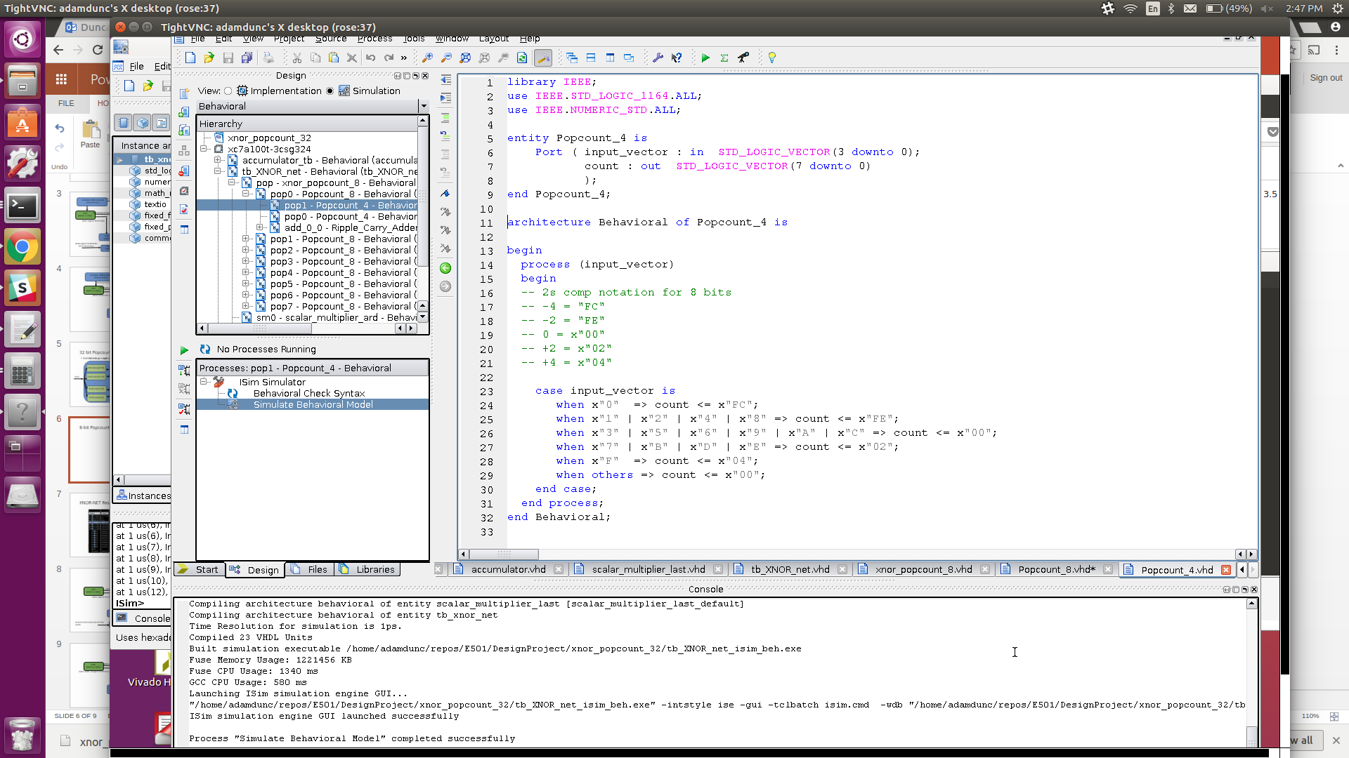
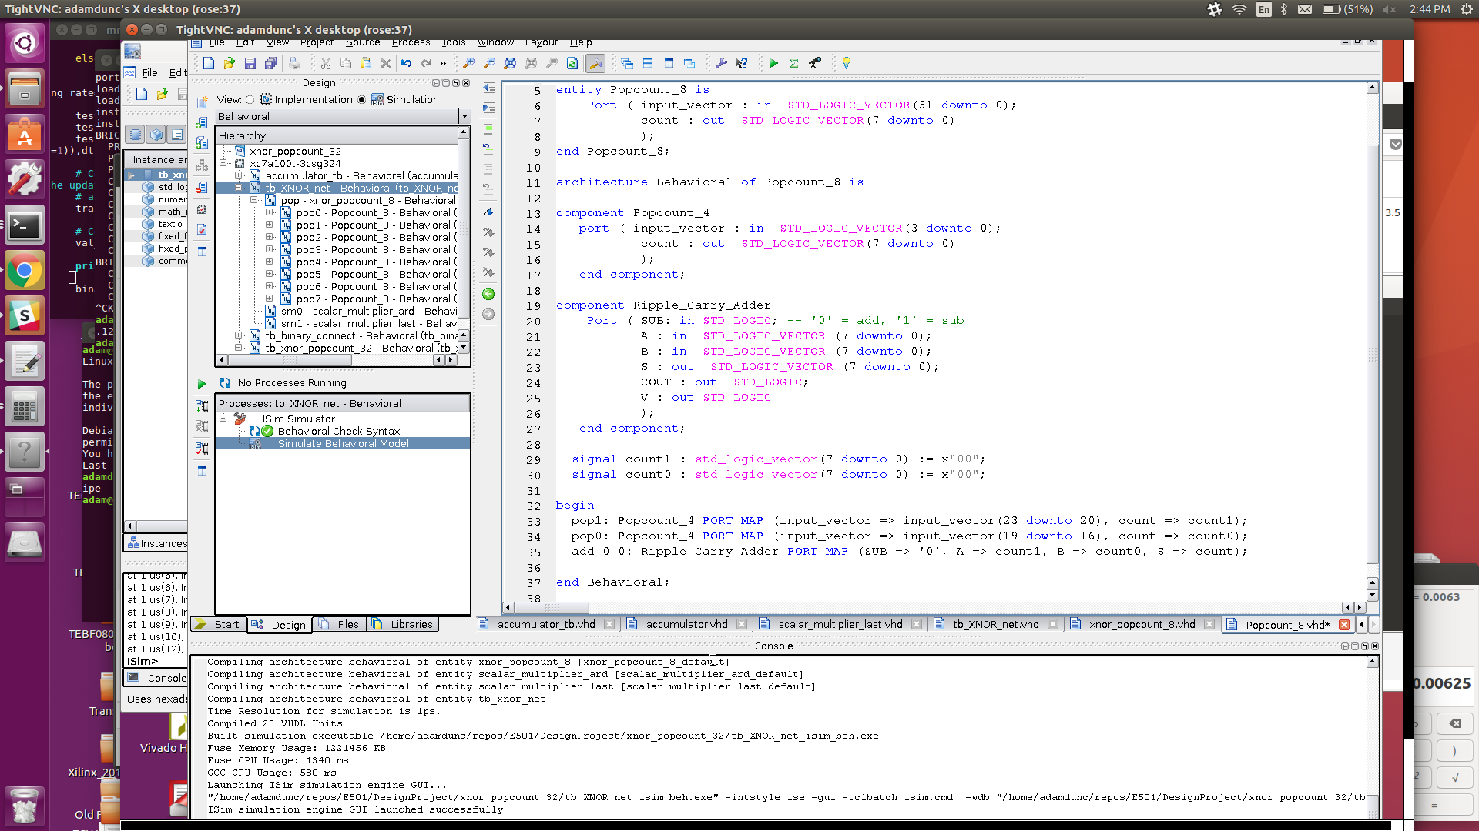
8-bit Popcount Design
8-bit Style | # RCA | # LUT4 | Speed | Area
Just RCA | 9 | 0 | slow | large
RCA+LUT | 3 | 2 | fast | med
RCA+LUT opt | 1 | 2 | fast | small

Slide 14
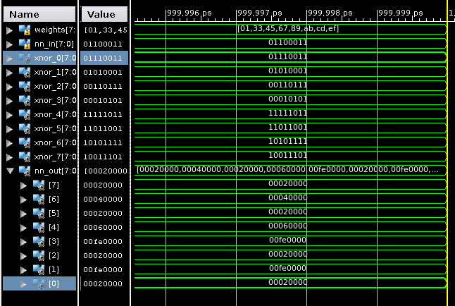
XNOR and Popcount Results

Slide 15
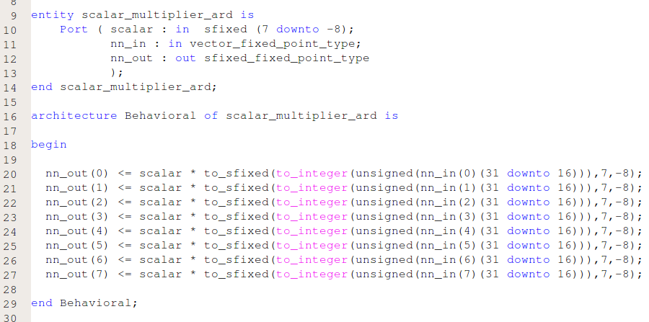
Scalar Multipliers
Multiplies a fixed point scalar value to an integer

Slide 16
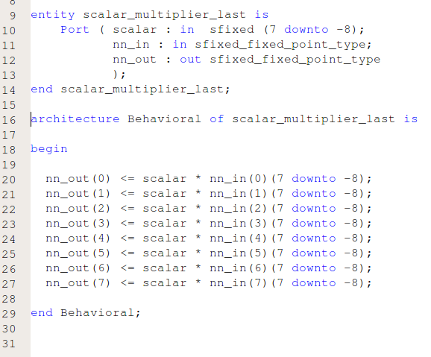
Scalar Multipliers
Multiplies a fixed point scalar value to a fixed point

Slide 17
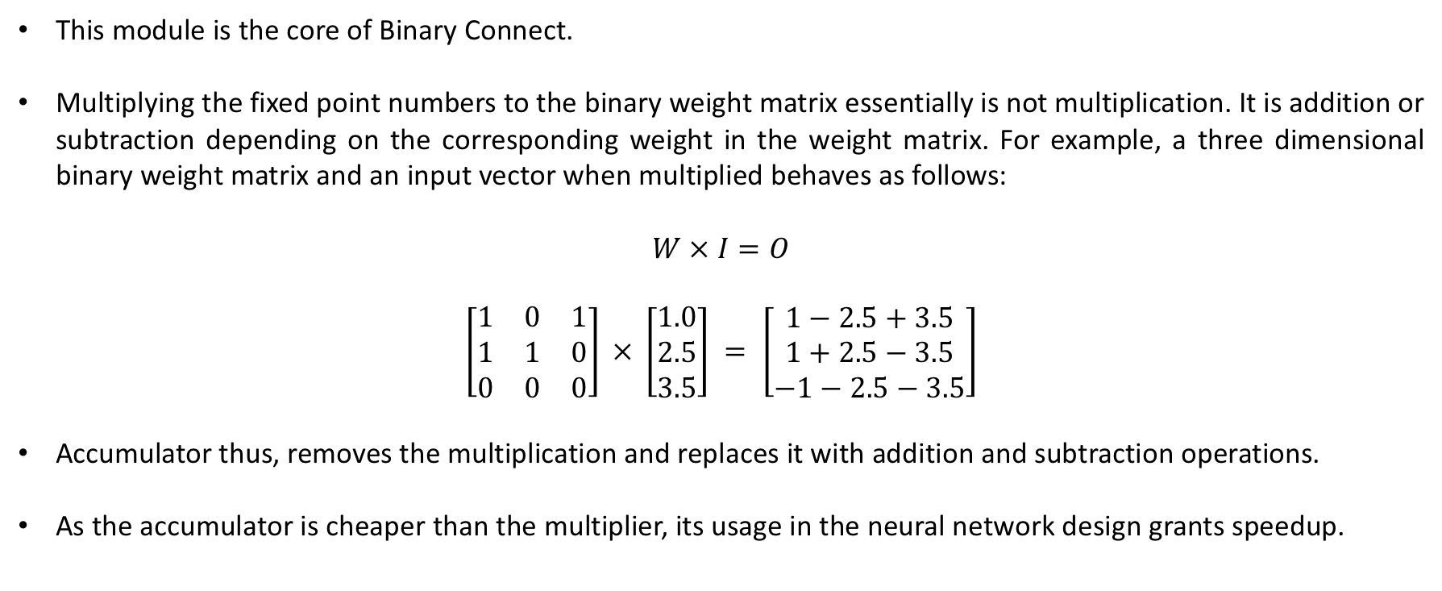
Accumulator
This module is the core of Binary Connect.
Multiplying the fixed point numbers to the binary weight matrix essentially is not multiplication. It is addition or subtraction depending on the corresponding weight in the weight matrix. For example, a three dimensional binary weight matrix and an input vector when multiplied behaves as follows:
$$\left[\begin{matrix}1 & 0 & 1 \\ 1 & 1 & 0 \\ 0 & 0 & 0\end{matrix}\right] × \left[\begin{aligned}1.0 \\ 2.5 \\ 3.5\end{aligned}\right] = \left[\begin{aligned}1−2.5+3.5 \\ 1+2.5−3.5 \\ −1−2.5−3.5\end{aligned}\right]$$
Accumulator thus, removes the multiplication and replaces it with addition and subtraction operations.
As the accumulator is cheaper than the multiplier, its usage in the neural network design grants speedup.

Slide 18
Block Diagram for accumulator
nn_in(7)
nn_in(1)
w0z
nn_in(0)
w0s0
w0s7
Adder/Subtractor
w0s6
w0s1
Adder/Subtractor
Adder/Subtractor
c
Weights(0)(0)
Weights(0)(7)
Weights(0)(1)
nn_in(7)
nn_in(1)
w0z
nn_in(0)
w1s0
w1s7
Adder/Subtractor
w1s6
w1s1
Adder/Subtractor
Adder/Subtractor
c
Weights(1)(0)
Weights(1)(7)
Weights(1)(1)

Slide 19
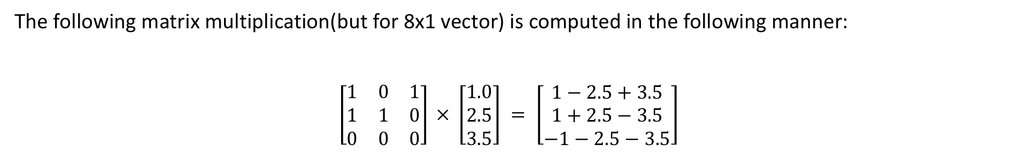
Computation mechanism
The following matrix multiplication(but for 8x1 vector) is computed in the following manner:
$$\left[\begin{matrix}1 & 0 & 1 \\ 1 & 1 & 0 \\ 0 & 0 & 0\end{matrix}\right] × \left[\begin{aligned}1.0 \\ 2.5 \\ 3.5\end{aligned}\right] = \left[\begin{aligned}1−2.5+3.5 \\ 1+2.5−3.5 \\ −1−2.5−3.5\end{aligned}\right]$$

Slide 20
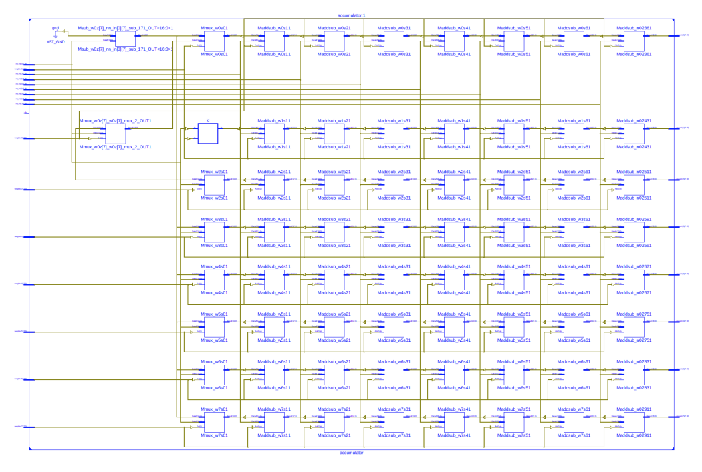
Schematic

Slide 21
Waveform

Slide 22
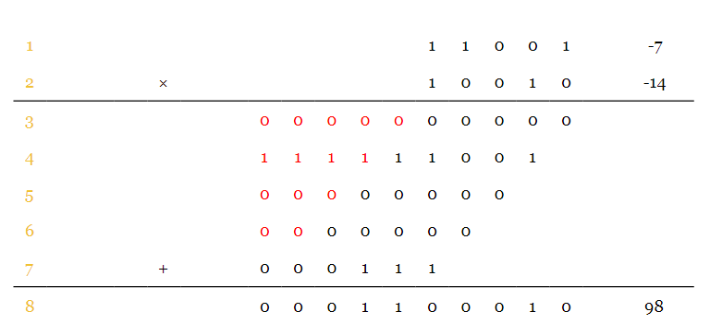
Scalar multiplier
Implementation of a 32-bit fixed-point multiplication
16-bit inputs: 1-bit signal, 7-bit integer, 8-bit fraction
To perform fixed-point multiplication
Consider inputs as two-complements and do 'normal' multiplication, then determine where the "point" is.
Source: https://www.allaboutcircuits.com/technical-articles/multiplication-examples-using-the-fixed-point-representation/

Slide 23
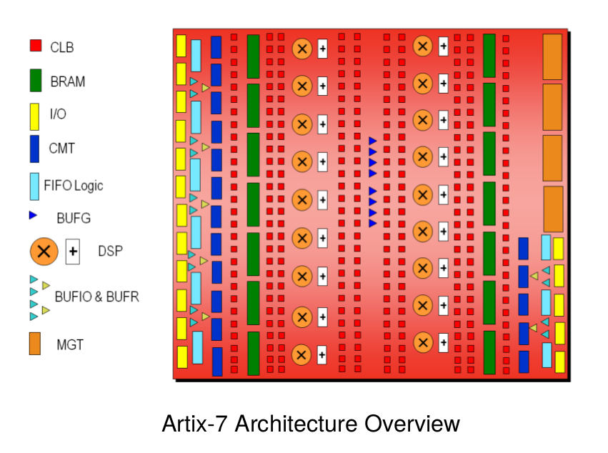
Xilinx 7 Series FPGA

Slide 24
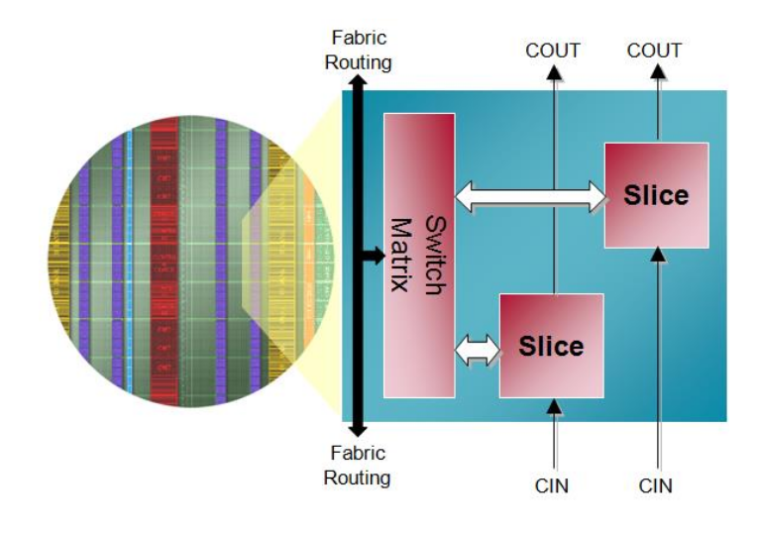
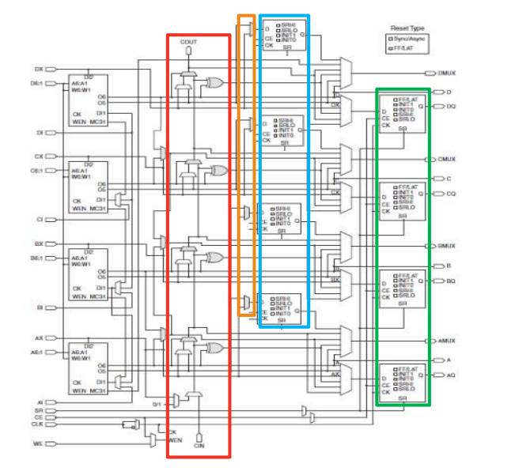
Xilinx 7 Series FPGA
Configurable Logic Block
Combinatorial functions
Flip-Flops
Slices
Four six-input LUTs
Multiplexers
Carry Chains
Four Flip-Flops/Latches (plus another 4)

Slide 25
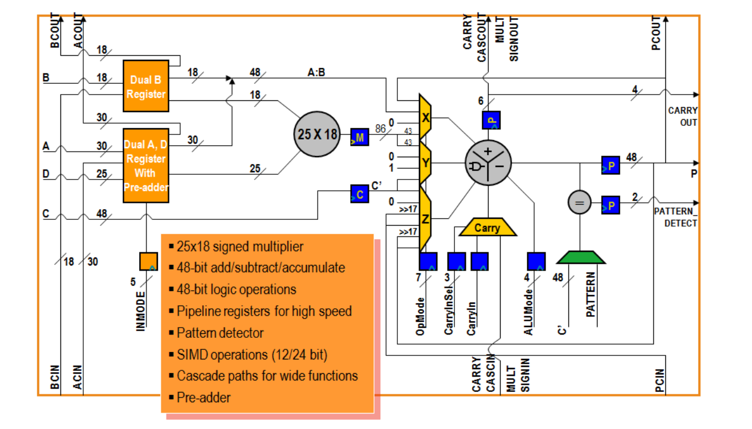
Xilinx 7 Series FPGA
Remarks: 3-stage pipeline
Source: Xilinx

Slide 26
Scalar Multiplier
Besides VHDL version, we designed two more implementations to study resource allocations.
Verilog – small latency/area intensive
Verilog - DSP

Slide 27
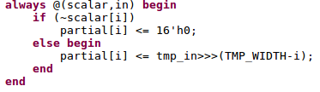
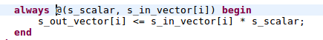
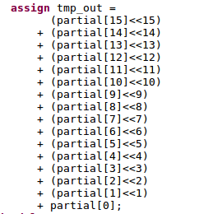
Verilog: Area intensive vs DSP
Area:
DSP
Note: I index 16-bit value in vector
Note: I indexes bits in 16-bit value

Slide 28
Verilog: Area intensive vs DSP
Area:
DSP
Slice Logic Utilization:
Number of Slice LUTs: 3288 out of 63400 5%
Number used as Logic: 3288 out of 63400 5%
Slice Logic Distribution:
Number of LUT Flip Flop pairs used: 3288
Number with an unused Flip Flop: 3288 out of 3288 100%
Number with an unused LUT: 0 out of 3288 0%
Number of fully used LUT-FF pairs: 0 out of 3288 0%
Multiplexers : 968
1-bit 2-to-1 multiplexer : 968
DSP
Number of DSP48E1s: 0 out of 240 0%
Slice Logic Distribution:
Number of LUT Flip Flop pairs used: 0
Number with an unused Flip Flop: 0 out of 0
Number with an unused LUT: 0 out of 0
Multiplexers = : 0
1-bit 2-to-1 multiplexer : 0
DSP
Number of DSP48E1s: 24 out of 240 10%

Slide 29
Results

Slide 30
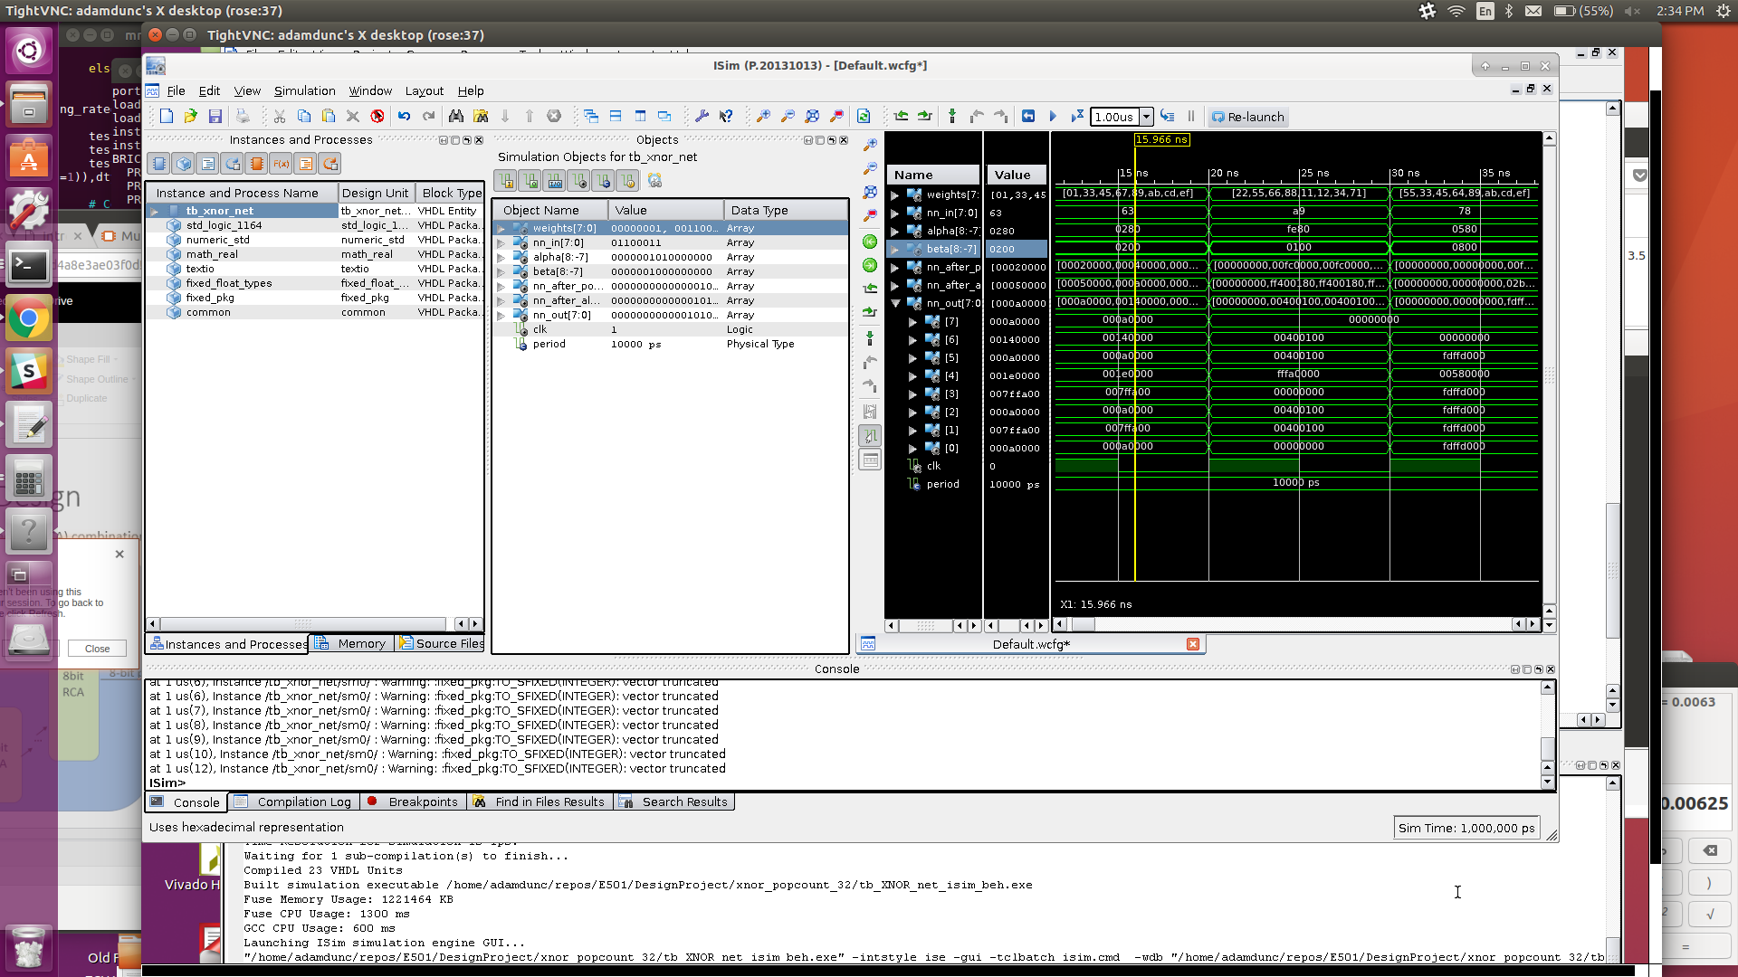
XNOR-NET Results

Slide 31
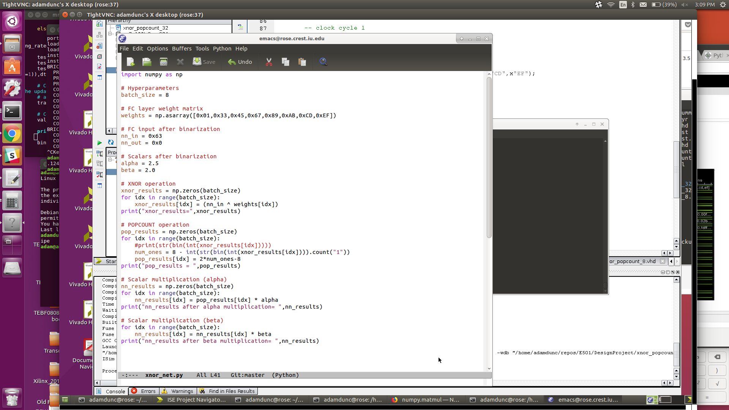
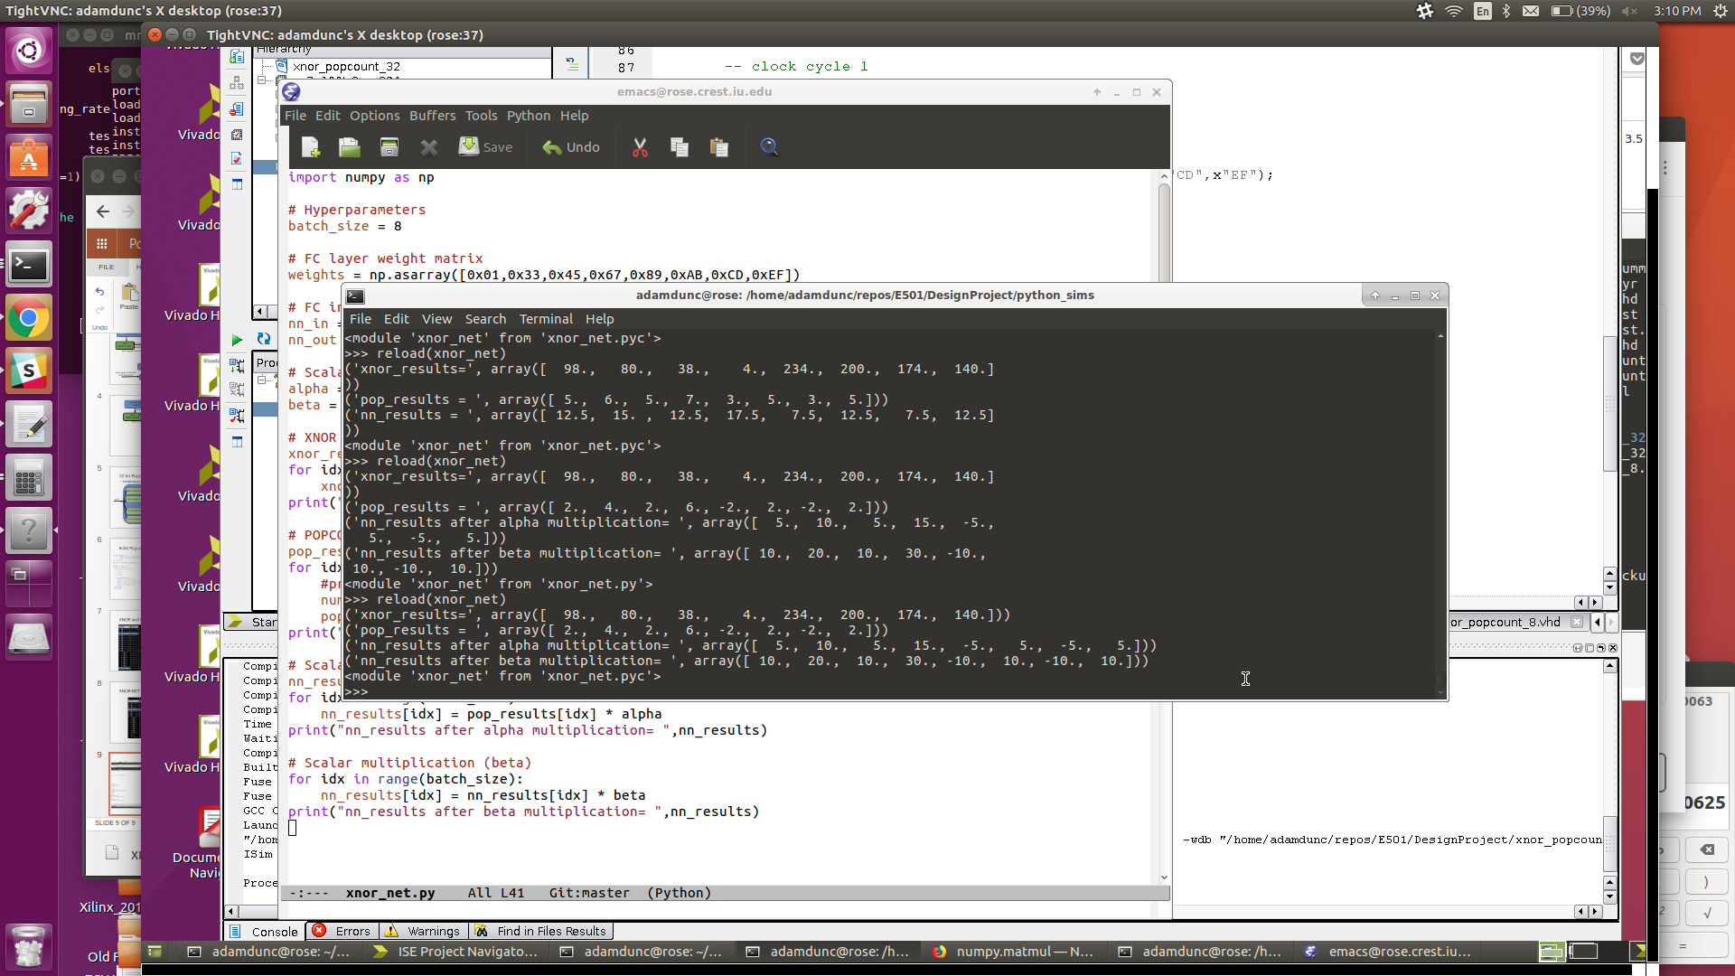
Python Verification of XNOR-Net

Slide 32
Binary Connect Results

Slide 33
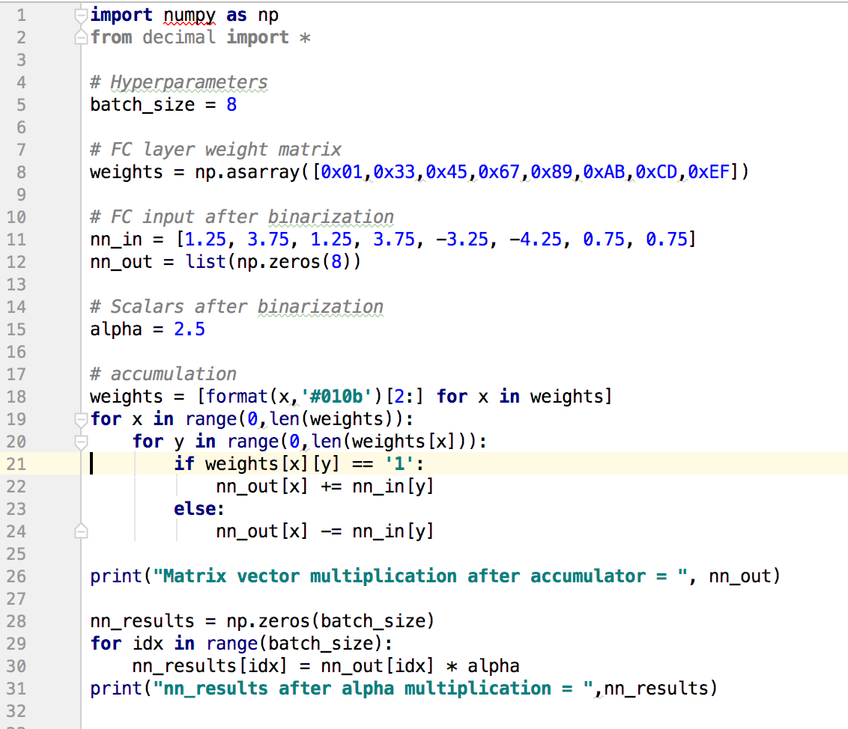
Python Verification of Binary Connect

